Slide 1
Merger of Zee Entertainment Ltd. and Sony Pictures Networks India
By Team 7-Avni Gour, Keerthi S, Sharvil Sachin Athaley

Slide 2
INTRODUCTION
WHAT IS A MERGER?
A merger is the type of business combination where two companies join together to form a new company. It takes place when one company (the surviving company) takes over another company (the merged company).
WHAT IS THE PURPOSE OF A MERGER?
increase of overall competitive advantage
revenue growth
business growth
entry into new markets
cost reduction.

Slide 3
Media and Entertainment industry-industry target and acquirers operate in
Industry Scenario
India is spending 80% of its time on mobile phone apps on media and entertainment.
India’s Media & Entertainment industry is expected to grow to $55-70 Bn by 2030 at 10-12% CAGR, led by OTT, Gaming, Animation and VFX.
Demand for regional content consumption is on the rise. The share of regional content in TV and OTT consumption is expected to reach 60% and 50% respectively by 2025
Video viewers have increased to 497 Million, i.e., around 94% of smartphone owners and wired broadband subscribers
At 1.5 bn hours, Indians spent amongst the most time on online sports in the world, around a third of global time spent on sports apps
Animation segment saw huge demand from OTT platforms and kids channels

Slide 4
Merger of Zee entertainment enterprises and Sony pictures network India
To start off with Zee Entertainment Enterprises Limited (ZEEL) is a media and entertainment company engaged in providing broadcasting services. The company operates through content and broadcasting segment.
On the other hand Sony pictures network Sony Pictures Entertainment Inc. is an American diversified multinational mass media and entertainment studio which is indirectly wholly owned subsidiary of Sony group corporation , Japan.

Slide 5
WHY A MERGER WITH ZEE ENTERTAINMENT????
Till 2017, the Sony network had the broadcast rights to the Indian Premier League (IPL), the country’s marquee cricket tournament. Between FY15 and FY18, its revenue almost doubled from Rs 3,342 crore to Rs 6,277 crore, while net profit shot up 6x. But in September 2017, Star & Disney India (then Star India) bagged the IPL broadcasting rights, and Sony’s revenue stagnated (Rs 5,640 crore in FY21), while net profit dropped to Rs 564 crore from Rs 976 crore in FY20.
Sony has negligible regional presence—one channel each in Bengali and Marathi—and together their revenue is less than Rs 100 crore each year.

Slide 6
With a combined revenue of $1.79 billion, this would be the second largest entertainment network after Star & Disney India, which has revenues of $1.8 billion, a shade more than the new entity. Importantly, the Zee-Sony entity will have 75 channels and a strong presence in entertainment, sports and regional markets, making it a serious player.

Slide 7
COMPETITORS IN THEIR SECTOR……
Zee entertainment and Sony pictures faces major competition from its peer companies Sun TV Network an Indian mass media company headquartered in Chennai, Tamil Nadu, India and Disney Star Private Limited which is an Indian media conglomerate and a wholly owned subsidiary of The Walt Disney Company India. It is headquartered in Mumbai, Maharashtra. Disney Star is the largest television and entertainment network in India.
Its other competitors include Reliance Mediaworks in Mumbai, India and OSN, MELS ,and Mercury Networks outside India.

Slide 8
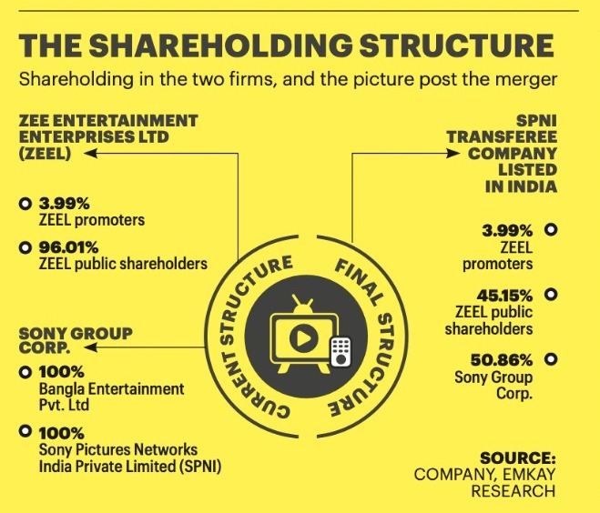
SHAREHOLDING:BEFORE AND AFTER MERGER
Before merger Zee entertainments had an approximately share of 96.01% for public shareholders in which 18% is owned by Invesco which makes it the largest stakeholder of Zee and 3.99% owned by its promoters.
On the other hand Sony group owned 100% of Sony pictures network .
After merger Sony’s shareholders hold 50.86% stake in the merged company, while ZEEL shareholders will hold 45.15% of the entity. Currently, 96.01% of ZEEL shareholding is public, while 3.99% is held by its promoters.

Slide 9
Before merger
After merger

Slide 10
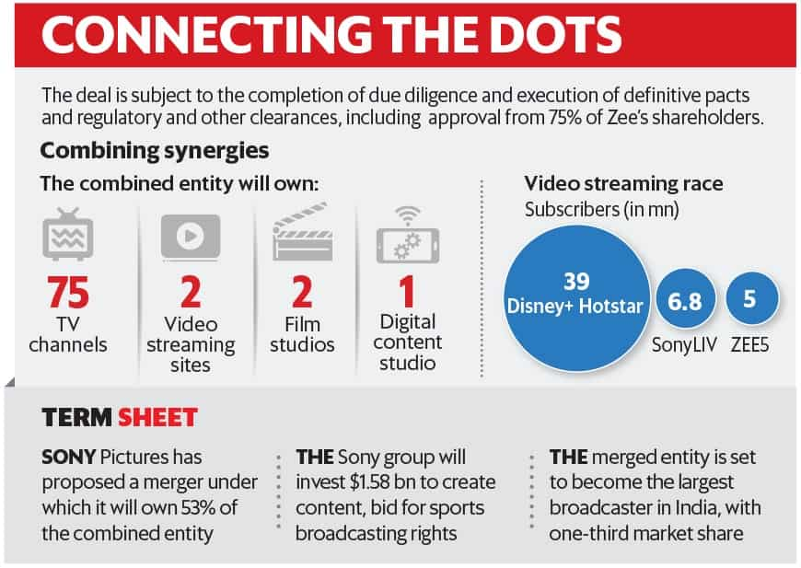
BENEFITS OF ZEE AND SONY MERGER….
With the Zee-Sony merger, viewers of the Sony network in India will gain access to over 260,000 hours of Zee television content and also its film library with rights to more than 4,800 movie titles across languages.
It will combine OTT networks, film studios, channels and content studios on the digital side. Since neither has truly competing products, the two will complement each other very well.
The combined entity will own 75 television channels, two video streaming services, two film studios and a digital content studio to be a formidable media firm.

Slide 11
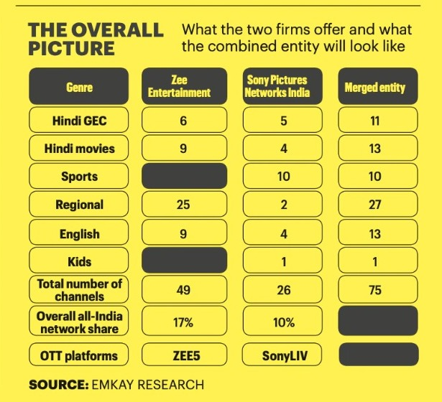
Sony has a strong viewers base in terms of sports and mainstream GECs (general entertainment channels), whereas Zee has a strong recall in the regional space, which is less or absent for Sony. Hence the merger will give a wide range of viewer base.
In terms of OTT the merged video-streaming offering will also bring in differentiated content, given that Sony LIV has a stronger catalogue of sports and fiction shows such as Scam 1992- The Harshad Mehta Story, whereas ZEE5 is into regional web series.
ZEE5 has a 13.2 percent market share and Sony LIV has 5.8 percent. As a combined entity, Zee-Sony can take the third spot in the subscription video on-demand (SVOD) market with a market share of 19 percent. The top players in the SVOD space are Disney+Hotstar with a market share of 26.3 percent followed by Netflix at 25.3 percent.

Slide 12
Some insight on how the merger is beneficial:

Slide 13
DCF Valuation
Discounted cash flow (DCF) is a method of valuation used to determine the value of an investment based on its return in the future–called future cash flows. DCF helps to calculate how much an investment is worth today based on the return in the future.
The weighted average cost of capital (WACC) is typically used as a hurdle rate, meaning the investment's return must outperform the hurdle rate.
The weighted average cost of capital (WACC) represents a firm's average cost of capital from all sources, including common stock, preferred stock, bonds, and other forms of debt. The weighted average cost of capital is a common way to determine required rate of return because it expresses, in a single number, the return that both bondholders and shareholders demand in order to provide the company with capital. A firm’s WACC is likely to be higher if its stock is relatively volatile or if its debt is seen as risky because investors will demand greater returns.
Although DCF is the standard for valuing privately-held companies; it can also be used as an acid test for publicly-traded stocks.

Slide 14
EPS Accretion Dilation Analysis
What is EPS?
Earnings per share (EPS) is designed to allow for comparison between businesses of different sizes. This shows the earnings for the period on a per share basis. It is used in many situations including the calculation of price earnings (PE) ratios and EPS accretion / dilution in M&A situations.
EPS accretion / dilution allows shareholders of an acquirer company to see whether an acquisition of a target will lead to an increase in their earnings per share. It is an important metric in deciding whether the acquisition should go ahead or not
The deal will be accretive when pro forma EPS is higher than standalone EPS. The deal will be dilutive when pro forma EPS is lower than standalone EPS
Pro forma net income combines the acquirer’s net income, the target’s net income, and any transaction effects (usually post tax synergies and added interest from issuance of debt)

Slide 15
Links to google spreadsheets
DCF Sheet- https://docs.google.com/spreadsheets/d/15WGj5RJcB0evAEzE_BF1KM8upkvVMq1M/edit?usp=sharing&ouid=102033629191352224220&rtpof=true&sd=true
EPS Sheet- Copy of EPS Accretion Deal Analysis Template.xlsx - Google Sheets

Slide 16
 |  |  |  |  |  | Target Firm Valuation
 |  |  |  |  |  | Discounted Cash Flow Analysis
(INR in millions, Financial Year March 31)
Operating Scenario
 |  |  | Historical Period |  |  | CAGR |  | Forecasted Period
 |  |  | 2019 | 2020 | 2021 | ('19 - '21) | 2022 | 2023 | 2024 | 2025 | 2026 | 2027
Sales |  |  | 81,854 | 84,135 | 78,403 | (0) | 84,675 | 90,603 | 96,039 | 100,841 | 104,874 | 108,020
% growth |  |  |  | 0 | (0) |  | 0 | 0 | 0 | 0 | 0 | 0
Cost of Goods Sold |  | 45.0% | 36,834 | 37,861 | 35,281 |  | 38,104 | 40,771 | 43,217 | 45,378 | 47,193 | 48,609
Gross Profit |  |  | 45,020 | 46,274 | 43,122 | -2.1% | 46,571 | 49,831 | 52,821 | 55,462 | 57,681 | 59,411
% margin |  |  | 1 | 1 | 1 |  | 1 | 1 | 1 | 1 | 1 | 1
Selling, General & Administrative |  | 25.0% | 20,464 | 21,034 | 19,601 |  | 21,169 | 22,651 | 24,010 | 25,210 | 26,219 | 27,005
EBITDA |  |  | 24,556 | 25,241 | 23,521 | -2.1% | 25,403 | 27,181 | 28,812 | 30,252 | 31,462 | 32,406
% margin |  |  | 0 | 0 | 0 |  | 0 | 0 | 0 | 0 | 0 | 0
Depreciation & Amortization |  |  | 2,681 | 2,815 | 2,956 |  | 2,316 | 2,432 | 2,553 | 2,681 | 2,815 | 2,956
EBIT |  |  | 21,875 | 22,425 | 20,565 | -3.0% | 23,087 | 24,749 | 26,258 | 27,571 | 28,647 | 29,450
% margin |  |  | 0 | 0 | 0 |  | 0 | 0 | 0 | 0 | 0 | 0
Taxes |  | 35.0% | 7,656 | 7,849 | 7,198 |  | 8,080 | 8,662 | 9,190 | 9,650 | 10,027 | 10,308

Slide 17
EBIT(1-T) |  |  | 14,219 | 14,576 | 13,367 | -3.0% | 15,006 | 16,087 | 17,068 | 17,921 | 18,621 | 19,143
Plus: Depreciation & Amortization |  |  | 2,681 | 2,815 | 2,956 |  | 2,316 | 2,432 | 2,553 | 2,681 | 2,815 | 2,956
Less: Capital Expenditures |  | 11% | 7,347 | 6,171 | (8,472) |  | (9,150) | (9,791) | (10,378) | (10,897) | (11,333) | (11,673)
Less: Inc./(Dec.) in Net Working Capital |  |  | 10225.0 | 10616.0 | 2138.0 |  | (6,471) | (7,118) | (7,830) | (8,613) | (9,474) | (10,422)
Unlevered Free Cash Flow |  |  |  |  |  |  | 1,701 | 1,610 | 1,413 | 1,092 | 629 | 4
WACC |  |  | 12.30%
Discount Period |  |  |  |  |  |  | 1.0 | 2.0 | 3.0 | 4.0 | 5.0 | 6.0
Discount Factor |  |  |  |  |  |  | 0.890 | 0.793 | 0.706 | 0.629 | 0.560 | 0.499
Present Value of Free Cash Flow |  |  |  | 10.0 |  |  | 1,515 | 1,277 | 998 | 687 | 352 | 2
 |  | WACC Calculation |  | 10.7
Risk Free rate of Return -Rf |  | 7.40% | Beta |  | 0.98
Risk Premium - Rm-Rf |  | 5% | Cost of debt post tax-Kd |  | 0.0%
Weight of Debt -Wd |  | 0% | Weight of Equity-We |  | 100%
Cost of Equity-CAPM |  | 0
Cost of Capital-WACC |  | 0

Slide 18
Enterprise Value |  |  |  |  | Equity Value and Share Price |  |  |  |  | Perpetuity Growth Rate
Total Value Of NPV of Cash flows |  |  | 3315.4 |  | Enterprise Value |  |  | 94,034 |  | Terminal Year Free Cash Flow (2027E) |  |  | 4
 |  |  |  |  | Less: Total Debt |  |  | 129 |  | WACC |  |  | 0
 | Terminal Value ( Exit Multiple) |  |  |  | Less: Noncontrolling Interest |  |  | 1 |  | Terminal Value |  |  | 162,031
Terminal Year EBITDA (2027E) |  |  | 32,406 |  | Plus: Cash and Cash Equivalents |  |  | 6,233
Exit Multiple |  |  | 5.0 |  |  |  |  |  |  | Implied Perpetuity Growth Rate |  |  | 0
Terminal Value |  |  | 162,031
Discount Factor |  |  | 0.560 |  | Implied Equity Value |  |  | - |  | Implied EV/EBITDA
Present Value of Terminal Value |  |  | 90,719 |  |  |  |  |  |  | Enterprise Value |  |  | 94,034
 |  |  |  |  | Fully Diluted Shares Outstanding |  |  | 8,748 |  | 2015 EBITDA |  |  | 3500.0
Enterprise Value with Exit multiple |  |  | -
 |  |  |  |  | Implied Share Price |  |  | 11.4 |  | Implied EV/EBITDA |  |  | 27
 | Terminal Value ( Perpetuity Formula)
Terminal Year Cash Flow |  |  | 4
Perpetuity Growth rate |  |  | 0
Terminal Value |  |  | 44
Discount Factor |  |  | 0.560
Present Value of Terminal Value |  |  | 25
Enterprise Value with Perpetuity approach |  |  | -

Slide 19
 | Sensitivity Analysis
 | (INR in millions)
 | Enterprise Value with exit multiple |  |  |  |  |  |  | Implied Perpetuity Growth Rate
 |  | Exit Multiple |  |  |  |  |  |  | Exit Multiple
 | 94034.4 | 6.5 | 7.0 | 7.5 | 8.0 | 8.5 |  | 3.03% | 6.5 | 7.0 | 7.5 | 8.0 | 8.5
WACC | 9.0% | 140216.0 | 150747.0 | 161278.0 | 171809.0 | 182340.0 | WACC | 9% | -0.1% | -0.1% | -0.1% | -0.1% | -0.1%
 | 9.5% | 137119.0 | 147412.0 | 157704.0 | 167997.0 | 178289.0 |  | 9.5% | 0.4% | 0.4% | 0.4% | 0.4% | 0.4%
 | 10.0% | 134106.0 | 144166.0 | 154277.0 | 164288.0 | 174349.0 |  | 10.0% | 0.9% | 0.9% | 0.9% | 0.9% | 0.9%
 | 10.5% | 131173.0 | 141008.0 | 150844.0 | 160679.0 | 170514.0 |  | 10.5% | 1.4% | 1.4% | 1.4% | 1.4% | 1.4%
 | 11.0% | 128319.0 | 137935.0 | 147551.0 | 157166.0 | 166782.0 |  | 11.0% | 1.9% | 1.9% | 1.9% | 1.9% | 1.9%
 | Equity Value
 |  | Exit Multiple
 | 100137.4 | 6.5 | 7.0 | 7.5 | 8.0 | 8.5
WACC | 9.0% | 146319.0 | 156850.0 | 167381.0 | 177912.0 | 188443.0
 | 9.5% | 143222.0 | 153515.0 | 163807.0 | 174100.0 | 184392.0
 | 10.0% | 140209.0 | 150269.0 | 160380.0 | 170391.0 | 180452.0
 | 10.5% | 137276.0 | 147111.0 | 156947.0 | 166782.0 | 176617.0
 | 11.0% | 134422.0 | 144038.0 | 153654.0 | 163269.0 | 172885.0

Slide 20
EPS Accretion Dilation Analysis
What is EPS?
Earnings per share (EPS) is designed to allow for comparison between businesses of different sizes. This shows the earnings for the period on a per share basis. It is used in many situations including the calculation of price earnings (PE) ratios and EPS accretion / dilution in M&A situations.
EPS accretion / dilution allows shareholders of an acquirer company to see whether an acquisition of a target will lead to an increase in their earnings per share. It is an important metric in deciding whether the acquisition should go ahead or not
The deal will be accretive when pro forma EPS is higher than standalone EPS. The deal will be dilutive when pro forma EPS is lower than standalone EPS
Pro forma net income combines the acquirer’s net income, the target’s net income, and any transaction effects (usually post tax synergies and added interest from issuance of debt)

Slide 21
SIMPLE MODEL: EPS ACCRETIVE /DILUTIVE DEAL ANALYSIS WITH DIFFERENT SCENARIOS
EPS Accretive/Dilutive Deal Calculation
INPUT DATA |  | Scenario 1 | Scenario 2 | Scenario 3 | Scenario 4 | Scenario 5 |  | Scenario 6
(figures in INR) | Acquirer | Target
 |  | No Premium |  |  |  | Premium offered per Share |  | 50% cash + 50% stock payment
Share price before announcement of M&A deal | 8157.86 | 261.55 | 262 |  | 262 | 262 | 262 | 262 | 262
Net Operating Income | 645628520000.00 | 16024000000.00 |  | 16,024,000,000 | 16,024,000,000 | 16,024,000,000 | 16,024,000,000 | 16,024,000,000 | 16,024,000,000
Earning per share-EPS | 521 | 17 | - | 17 | 17 | 17 | 17 | 17 | 17
Price/earning -P/E ratio | 16 | 16 | - | - | 16 | 16 | 16 | 16 | 16
Number of shares outstanding | 1240000000.00 | 960520000.00 | 960,520,000 | 960,520,000 | 960,520,000 | 960,520,000 | 960,520,000 | 960,520,000 | 960,520,000
Increase in Net income due to synergy gains |  | - | - | - |  | - | - | - | -

Slide 22
Scenario-1
Acquirer acquires target firm at Market price and pays through stock
P/E ratio of Target > P/E ratio of Acquirer
Exchange ratio more than one
 | Acquirer | Target | Post M&A
Share price before announcement | 8,158 | 262 | 332
P/E ratio | 16 | 16 | 23
EPS Next year | 521 | 17 | 521
Shares outstanding | 1,240,000,000 | 960,520,000 | 1,270,795,332
Net Income next years | 645,628,520,000 | 16,024,000,000 | 661,652,520,000
Equity Offer value(No. of shares X Offer price) |  |  | 251,224,006,000
Exchange ratio (Price of Target/Price of Acquirer) | 0.03
New shares issued to Target Firm SHs | 30,795,332
Total shares Of combined firm, Post M&A |  |  | 1,270,795,332
Net Income of combined firm post M&A |  |  | 661,652,520,000
EPS of combine firm post M&A |  |  | 521
EPS of Acquirer firm Before M&A |  |  | 521
Accretion(dilution) % to Acquirer post M&A |  |  | (0.00)

Slide 23
Scenario-2
Acquirer acquires target firm at Market price and pays through stock
P/E ratio of Target < P/E ratio of Acquirer
Exchange ratio more than one
 | Acquirer | Target | Combined
Share price before announcement | 8,158 | 262
P/E ratio | 16 | -
EPS Next year | 521 | - | 508
Shares outstanding | 1,240,000,000 | 960,520,000 | 1,270,795,332
Net Income | 645,628,520,000 |  | 645,628,520,000
Equity Offer value(No. of shares X Offer price) |  |  | 251,224,006,000
Exchange ratio (Price of Target/Price of Acquirer) | 0
New shares issued to Target Firm SHs | 30,795,332
Total shares Of combined firm, Post M&A |  |  | 1,270,795,332
Net Income of combined firm post M&A |  |  | 645,628,520,000
EPS of combine firm post M&A |  |  | 508
EPS of Acquirer firm Before M&A |  |  | 521
Accretion(dilution) % to Acquirer post M&A |  |  | -2.42%

Slide 24
Scenario-3
Acquirer acquires target firm at Market price and pays through stock
P/E ratio of Target < P/E ratio of Acquirer
Exchange ratio is Close to one.
 | Acquirer | Target | Combined
Share price before announcement | 8,158
P/E ratio | 16 | -
EPS Next year | 521 | 17 | 534
Shares outstanding | 1,240,000,000 | 960,520,000 | 1,240,000,000
Net Income next years | 645,628,520,000 | 16,024,000,000 | 661,652,520,000
Equity Offer value(No. of shares X Offer price) |  |  | -
Exchange ratio (Price of Target/Price of Acquirer) | -
New shares issued to Target Firm SHs | -
Total shares Of combined firm, Post M&A |  |  | 1,240,000,000
Net Income of combined firm post M&A |  |  | 661,652,520,000
Increase in Net income due to synergy gains | -
Net Income of combined firm adjusted with synergy gain |  |  | 661,652,520,000
EPS of combine firm post M&A |  |  | 534
EPS of Acquirer firm Before M&A |  |  | 521
Accretion(dilution) % to Acquirer post M&A |  |  | 2.48%

Slide 25
Scenario-4
Acquirer acquires target firm at Market price and pays through stock
P/E ratio of Target > P/E ratio of Acquirer
Exchange ratio more than one
Increase in Net income due to synergy Gains
 | Acquirer | Target | Combined
Share price before announcement | 8,158 | 262
P/E ratio | 16 | 16
EPS Next year | 521 | 17 | 521
Shares outstanding | 1,240,000,000 | 960,520,000 | 1,270,795,332
Net Income next years | 645,628,520,000 | 16,024,000,000 | 661,652,520,000
Equity Offer value(No. of shares X Offer price) |  |  | 251,224,006,000
Exchange ratio (Price of Target/Price of Acquirer) | 0
New shares issued to Target Firm SHs | 30,795,332
Total shares Of combined firm, Post M&A |  |  | 1,270,795,332
Net Income of combined firm post M&A |  |  | 661,652,520,000
Increase in Net income due to synergy gains
Net Income of combined firm adjusted with synergy gain |  |  | 661,652,520,000
EPS of combine firm post M&A |  |  | 521
EPS of Acquirer firm Before M&A |  |  | 521
Accretion(dilution) % to Acquirer post M&A |  |  | 0.00%

Slide 26
Scenario-5
Acquirer acquires target firm at Preium over market price and pays through stock
P/E ratio of Target > P/E ratio of Acquirer
Exchange ratio more than one
Offers premium on share price(paid through stock)
 | Acquirer | Target | Combined
100% Acquistion of target with stock |  |  | No premium | With premium
 |  |  |  | INR 2 /share | INR 5 /share
Share price before announcement | 8,158 | 262 | 262 | 262 | 262
P/E ratio | 16 | 16
EPS Next year | 521 | 17 | 521 | 521 | 521
Shares outstanding | 1,240,000,000 | 960,520,000 | 1,270,795,332 | 1,270,795,332 | 1,270,795,332
Net Income | 645,628,520,000 | 16,024,000,000 | 661,652,520,000 | 661,652,520,000 | 661,652,520,000
Equity Offer value(No. of shares X Offer price) |  |  | 251,224,006,000 | 251,224,006,000 | 251,224,006,000
Exchange ratio (Price of Target/Price of Acquirer) |  |  | 0 | 0 | 0
New shares issued to Target Firm SHs |  |  | 30,795,332 | 30,795,332 | 30,795,332
Total shares Of combined firm, Post M&A |  |  | 1,270,795,332 | 1,270,795,332 | 1,270,795,332
Net Income of combined firm post M&A |  |  | 661,652,520,000 | 661,652,520,000 | 661,652,520,000
Increase in Net income due to synergy gains |  |  | - | - | -
Net Income of combined firm adjusted with synergy gain |  |  | 661,652,520,000 | 661,652,520,000 | 661,652,520,000
EPS of combine firm post M&A |  |  | 521 | 521 | 521
EPS of Acquirer firm Before M&A |  |  | 521 | 521 | 521
Accretion(dilution) % to Acquirer post M&A |  |  | 0.00% | 0.00% | 0.00%

Slide 27
Scenario-6
Acquirer acquires target firm with 50% cash and 50% stock payment
P/E ratio of Target > P/E ratio of Acquirer
Exchange ratio more than one
Offers premium on share price(paid through stock)
 | Acquirer | Target | Combined no premium
100% Acquistion of target with stock |  |  |  |  | With premium
 |  |  |  |  | INR 2 /share |  | INR 5 /share
 |  |  | 100% stock | 50% stock | 100% stock | 50% stock | 100% stock | 50% stock
Share price before announcement | 8,158 | 262 | 262 | 262 | 262 | 262 | 262 | 262
P/E ratio | 16 | 16
EPS Next year | 520.67 | 16.68 | 520.66 | 527.05 | 520.66 | 527.05 | 520.66 | 527.05
Shares outstanding | 1,240,000,000 | 960,520,000 | 1,270,795,332 | 1,255,397,666 | 1,270,795,332 | 1,255,397,666 | 1,270,795,332 | 1,255,397,666
Net Income next years | 645,628,520,000 | 16,024,000,000 | 661,652,520,000 | 661,652,520,000 | 661,652,520,000 | 661,652,520,000 | 661,652,520,000 | 661,652,520,000
Equity Offer value(No. of shares X Offer price) |  |  | 251,224,006,000 | 251,224,006,000 | 251,224,006,000
Exchange ratio (Price of Target/Price of Acquirer) |  |  | 0.03 | 0.03 | 0.03 | 0.03 | 0.03 | 0.03
New shares issued to Target Firm SHs |  |  | 30,795,332 | 15,397,666 | 30,795,332 | 15,397,666 | 30,795,332 | 15,397,666
Total shares Of combined firm, Post M&A |  |  | 1,270,795,332 | 1,255,397,666 | 1,270,795,332 | 1,255,397,666 | 1,270,795,332 | 1,255,397,666
Net Income of combined firm post M&A |  |  | 661,652,520,000 | 661,652,520,000 | 661,652,520,000 | 661,652,520,000 | 661,652,520,000 | 661,652,520,000
Increase in Net income due to synergy gains |  |  | - | - | - | - | - | -
Net Income of combined firm adjusted with synergy gain |  |  | 661,652,520,000 | 661,652,520,000 | 661,652,520,000 | 661,652,520,000 | 661,652,520,000 | 661,652,520,000
EPS of combine firm post M&A |  |  | 520.66 | 527.05 | 520.66 | 527.05 | 520.66 | 527.05
EPS of Acquirer firm Before M&A |  |  | 520.67 | 520.67 | 520.67 | 520.67 | 520.67 | 520.67
Accretion(dilution) % to Acquirer post M&A |  |  | 0.00% | 1.22% | 0.00% | 1.22% | 0.00% | 1.22%

Slide 28
SENSITIVITY ANALYSIS
 | SENSITIVITY ANALYSIS
 | %age stock payment |  | Premium Offered on share price
 | 1.5% | 20% | 30% | 40% | 50% | 60%
 | 30% | 1.8% | 1.7% | 1.6% | 1.5% | 1.4%
 | 40% | 1.4% | 1.4% | 1.3% | 1.2% | 1.0%
 | 50% | 1.2% | 1.0% | 0.9% | 0.8% | 0.6%
 | 60% | 0.9% | 0.7% | 0.6% | 0.4% | 0.2%
 | 70% | 0.6% | 0.4% | 0.2% | 0.1% | -0.1%
 | 80% | 0.2% | 0.1% | -0.1% | -0.2% | -0.5%

Slide 29
Football field Valuation
The valuation process involves making a significant number of forecasts and estimates to measure the financial performance of a company. Analysts make estimates about a firm’s business performance, the macroeconomic environment, market demand, and many other factors. However, these estimates are prone to uncertainties and are ultimately dependent on the analyst. Future cash flows could vary from estimates for various reasons including lower-than-expected demand (resulting in decreased sales), technological disruption, regulatory changes, etc. To deal with such uncertainties and reduce the margin for error, analysts may use more than one valuation methodology, such as those stated above, for valuing a single company.

Slide 30
Football Field Valuation of Zee Entertainment Ltd
 | Low | Diff | High
DCF value at 6.5 to 8.5 Exit Multiple | 139.9 | 56.2 | 196.2
DCF value at 0.9% to 1.9% perpetuity growth rate | 139.9 | 48 | 187.9
52 Week Market High/Low of share of company | 166.8 | 211.8 | 378.6

Slide 31
Football Field Valuation of Zee Entertainment Ltd

Slide 32
Links to google spreadsheets
DCF Sheet- https://docs.google.com/spreadsheets/d/15WGj5RJcB0evAEzE_BF1KM8upkvVMq1M/edit?usp=sharing&ouid=102033629191352224220&rtpof=true&sd=true
EPS Sheet- Copy of EPS Accretion Deal Analysis Template.xlsx - Google Sheets

